Slide 1
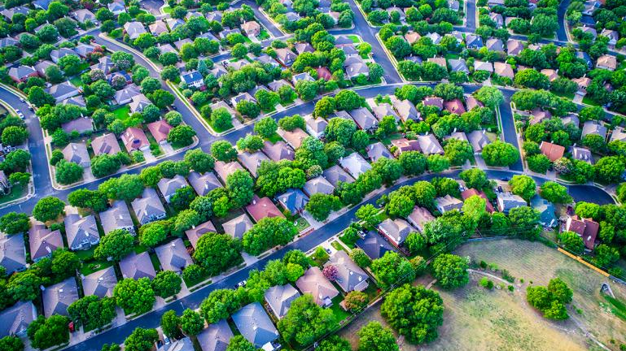
REAL ESTATE IN SEATTLE, WA
REGRESSION ANALYSIS

Slide 2

DELIVERABLES
Using the dataset of 22,000 houses sold between 2014-2015:
Build a model that will predict the price of a house based on features provided in the dataset.
Explore the characteristics of the houses using some business intelligence tools.
Gain understanding of which factors are responsible for higher property value - $650K and above.

Slide 3







PROCESSES
Datasets Results Available at

Slide 4

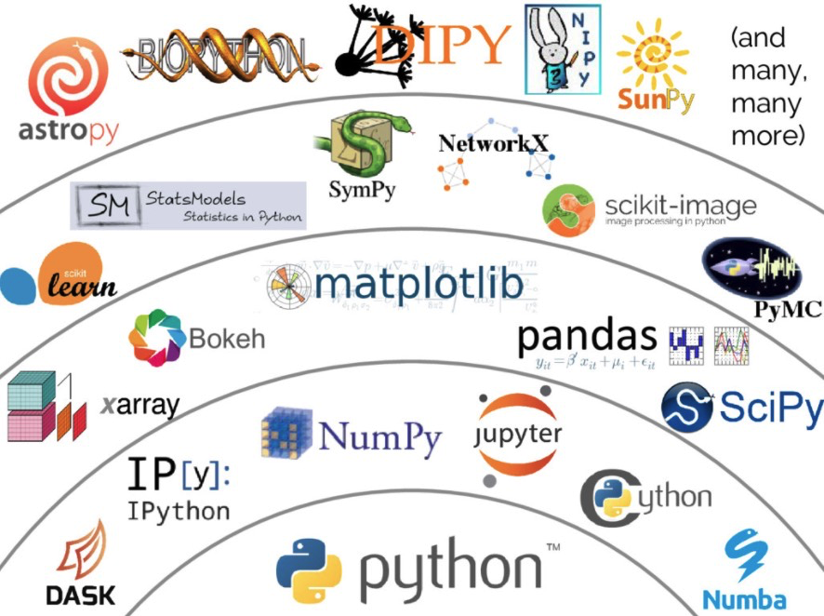
Get familiar with the data
Get familiar with the data
Explore the data
Data Cleaning
EDA
Data Wrangling
Model
Removal of nulls, errors and duplicates
Plots and visualisation
Normaliser and Scaler
Linear Regression
KNN

Slide 5
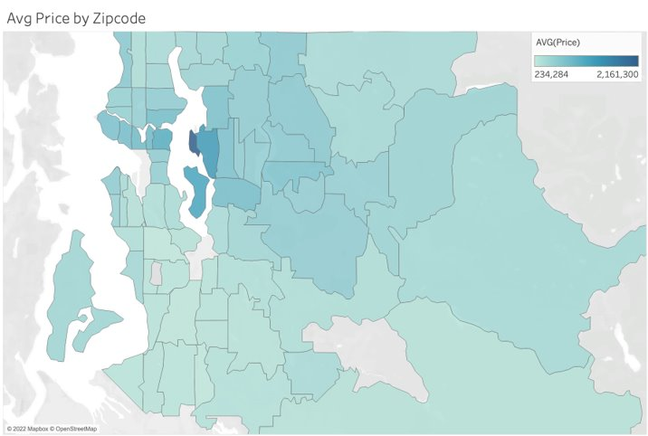
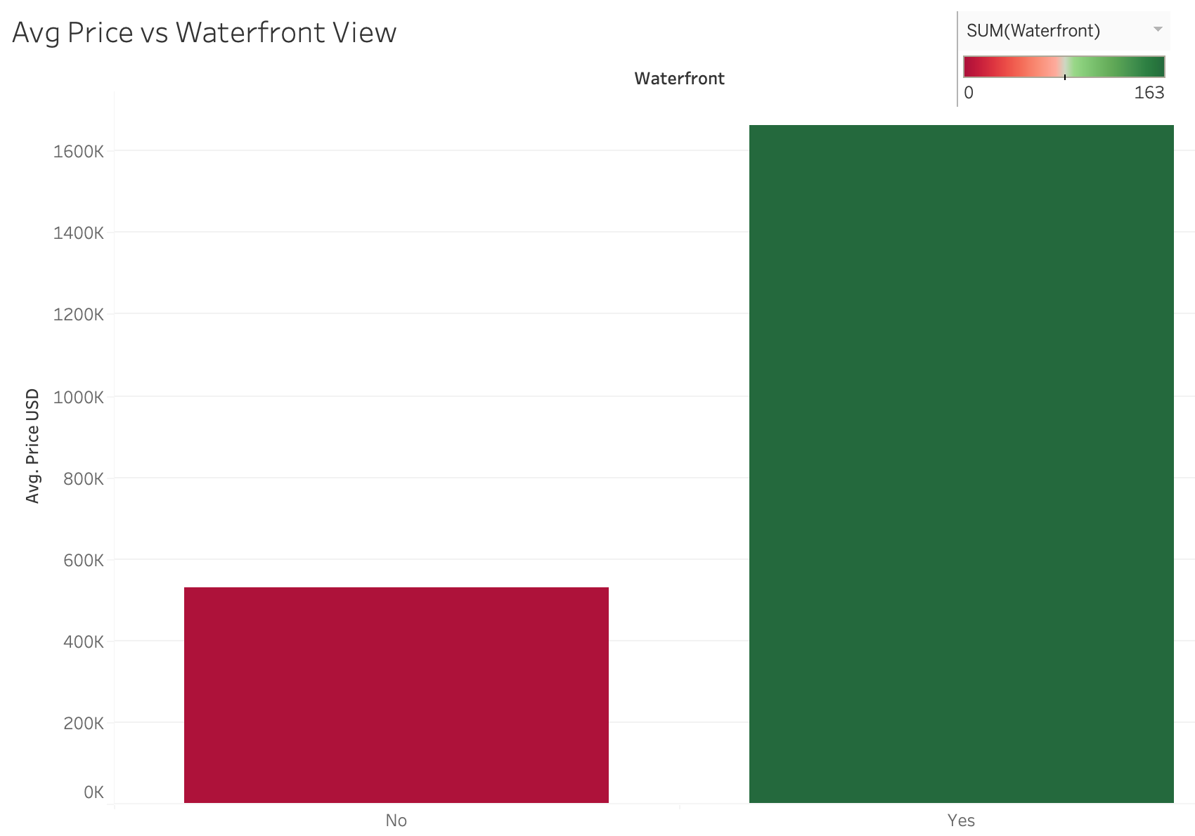
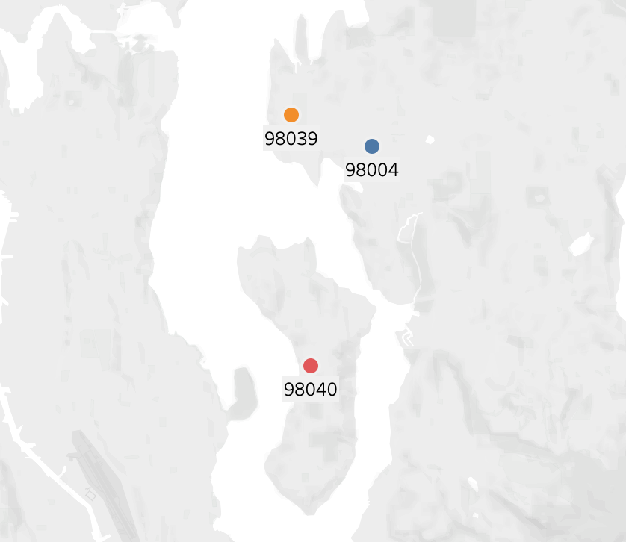
INSIGHTS
Available at Tableau

Slide 6
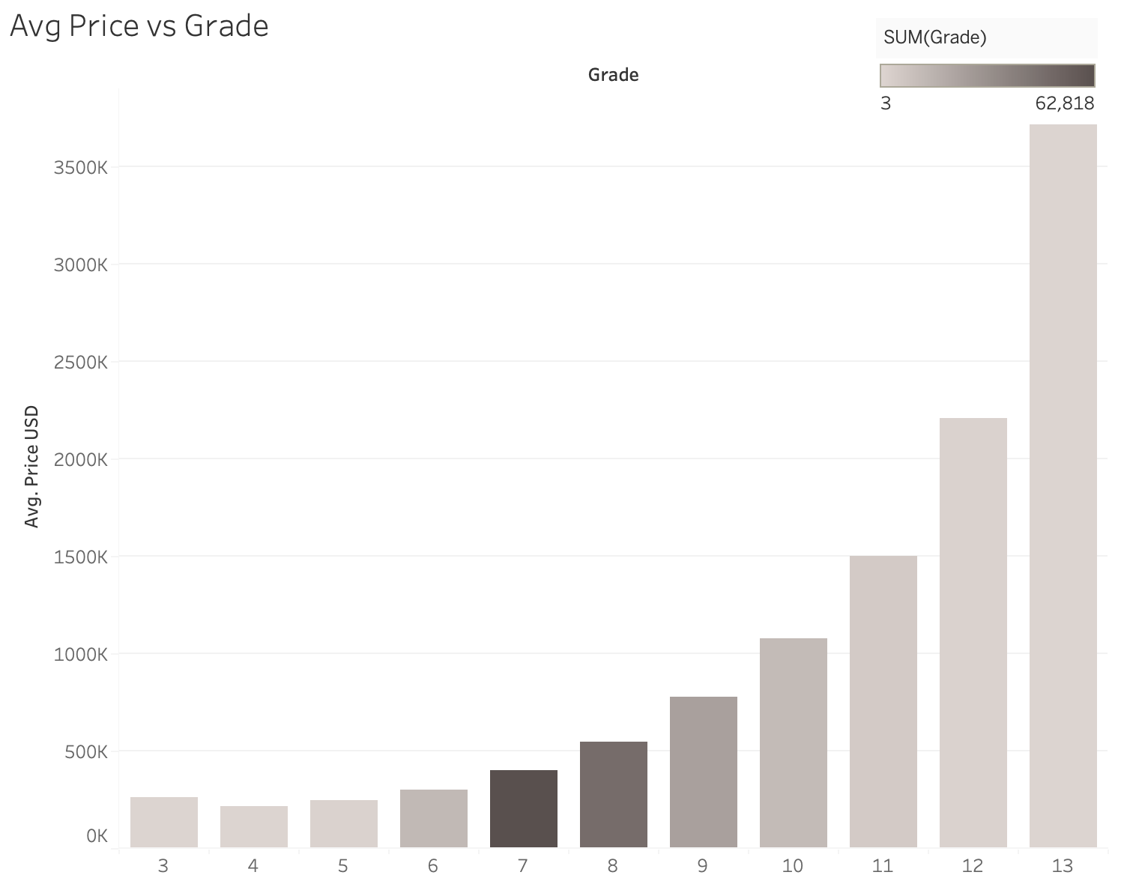
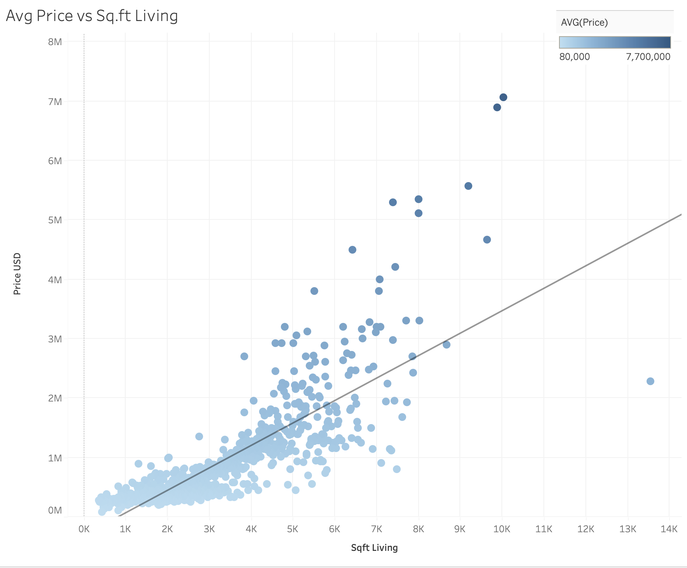
Available at Tableau

Slide 7
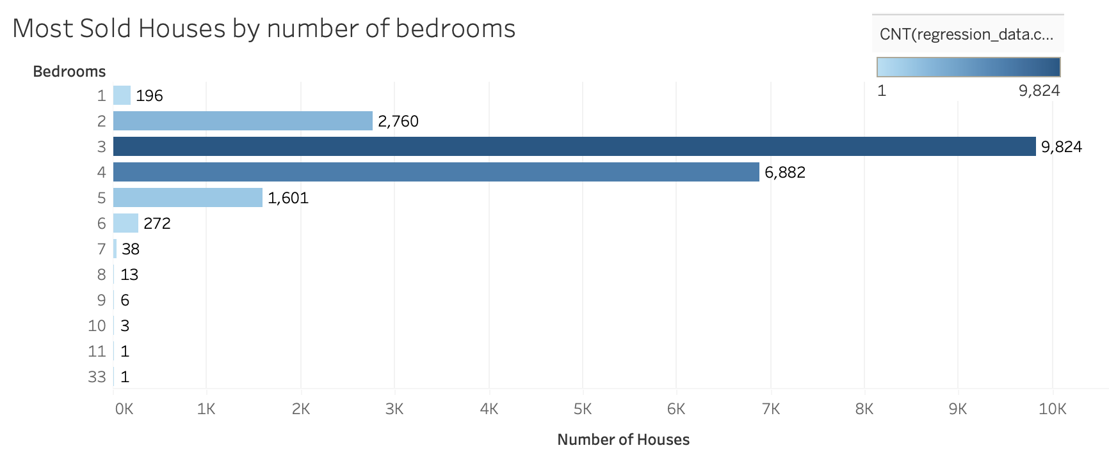
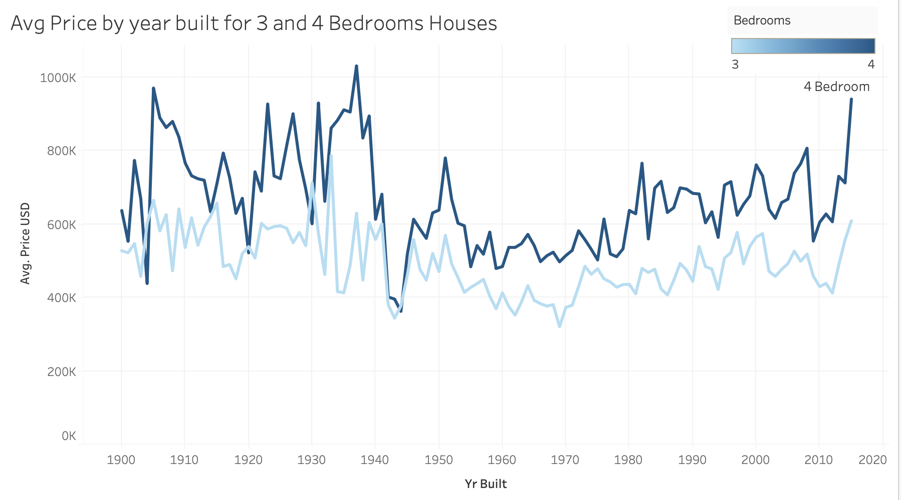
Available at Tableau

Slide 8
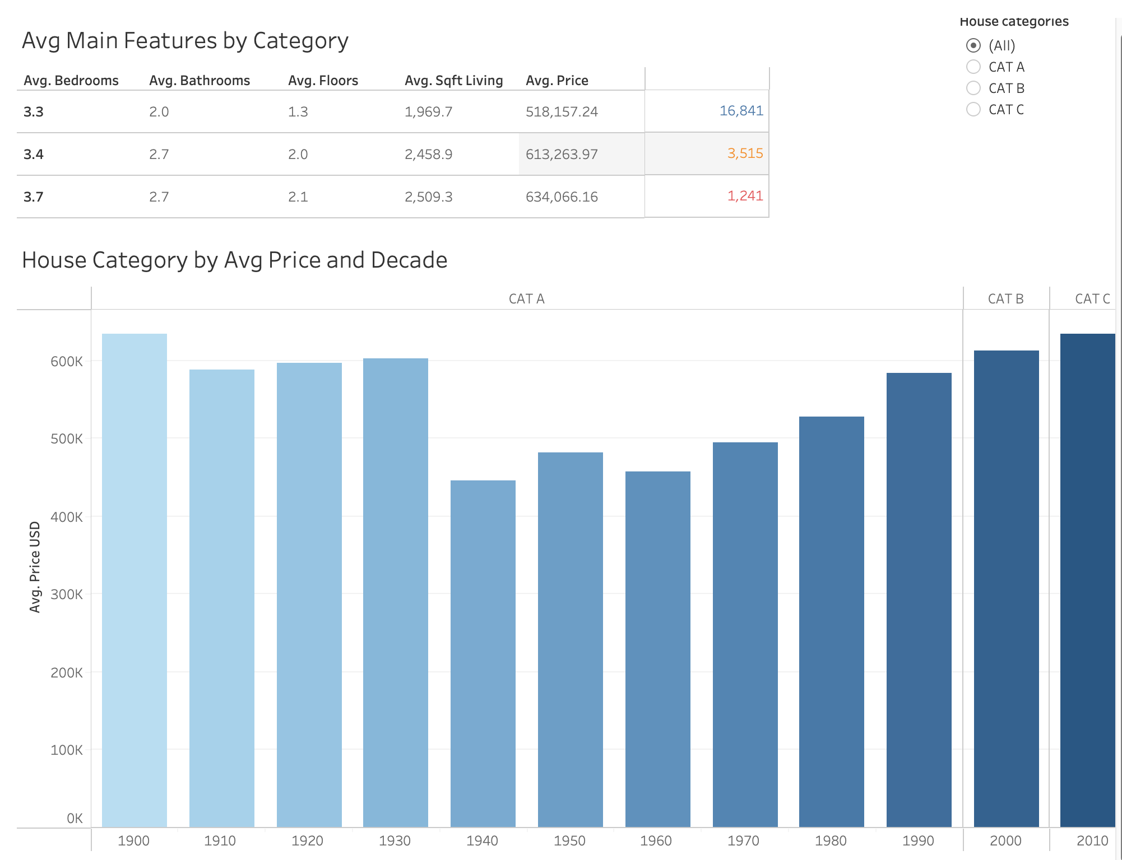
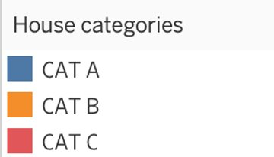
Available at Tableau

Slide 9
CONCLUSIONS
Our KNN model was the most accurate prediction model with R²0.78.
Houses built at beginning of the century and those after 2010 were the most expensive.
Waterfront view houses consisted of 1% of the dataset and therefore were a lot more expensive on average than those without a view.
Most popular houses were three and four bedrooms with 77% of the properties falling into that category.
Responsible factors for a property value of over $650,000:
Bedrooms 4
Bathrooms 2.5
Sq. ft Living 2,440
Condition 3
Grade 9

Slide 10
THANK YOU FOR YOUR TIME
PLEASE LET US KNOW IF YOU HAVE ANY QUESTIONS OR REVIEW THE INFORMATION ON GITHUB.
By Miguel Villoslada and Andrew Coupe

